Slide 1

Dynamics CRM Workflows 101

Slide 2

Mitch Milam
Dynamics CRM Architect
Independent consultant and trainer
mitch@xrmcoaches.com
infinite–x.net
@mitchmilam

Slide 3
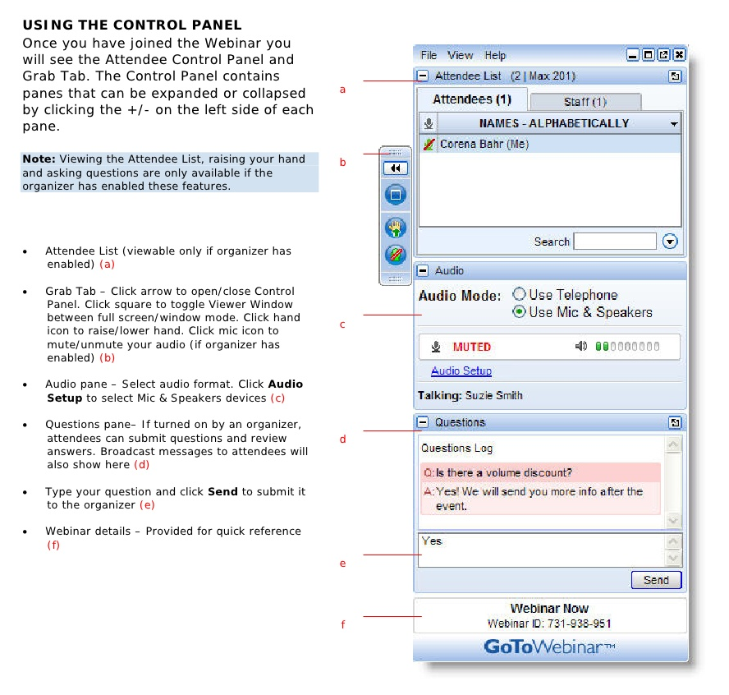
Webinar Housekeeping

Slide 4
Future Events
Workshop: Dynamics CRM Online Administration and Maintenance
Wednesday, February 17th at 10:00pm (Central Time US)
Webinar: Dynamics CRM Form Design: Art or Science?
Friday, February 19th. 10:00am (Central Time US)

Slide 5


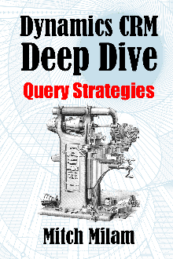
2016 Training Roadmap
Webinars
http://www.xrmcoaches.com/webinars
KnowledgeBits
http://www.xrmcoaches.com/knowledgebits
Learning Plans
Availability –Coming soon
More Goodies
Practice tests
On–Demand video training
Instructor–led training
Books

Slide 6
Agenda
Basics of creating a workflow
Properties
Steps
Management and troubleshooting
Additional resources

Slide 7
Overview

Slide 8
Workflows Overview
Allow for automation of repetitive tasks
Can be executed automatically or manually
Allows non–developers to create business processes
Can be extended with Custom Workflow Activities

Slide 9
Workflows Overview
May be created by anyone with security access
Must be Activated before use

Slide 10
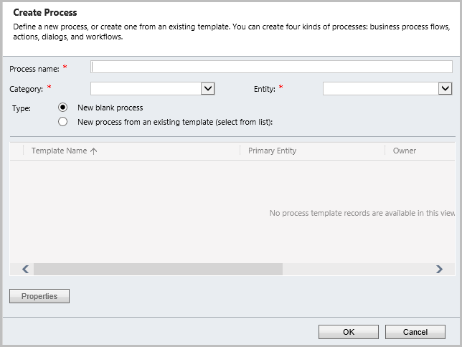
Create Process

Slide 11
Create Process
Name
Type
Action
Business Process Flow
Dialog
Workflow
Entity
From Blank or from Template

Slide 12
Process Templates
Allows you to define a process that will be used as the basis for another process

Slide 13

Main Properties

Slide 14
Main Properties
After creation, only the Name may be changed

Slide 15
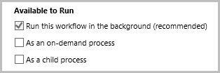
Available to Run

Slide 16

Workflow Job Retention

Slide 17
Scope
User
Business Unit
Parent: Child Business Units
Organization

Slide 18
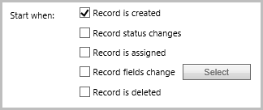
Start When

Slide 19
Workflow Steps

Slide 20
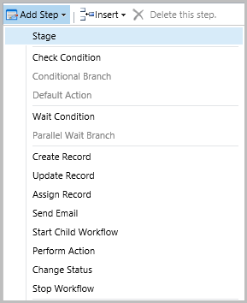
Steps

Slide 21
Working with Steps
Can be added
Can be deleted
Can be inserted before or after selected stage
Cannot be moved
Cannot be disabled

Slide 22
Step: Stage
Allows you to group a series of workflow steps
If a workflow has stages, then all steps must belong in a stage

Slide 23
Step: Check Condition
This is an IF statement
Checks for a condition before executing child steps

Slide 24
Step: Conditional Branch
This is an ELSE statement

Slide 25
Step: Default Action
Also known as an OTHERWISE statement

Slide 26
Step: Wait Condition
Waits for a specific condition to occur

Slide 27
Step: Parallel Wait Branch
Defines a secondary wait condition

Slide 28
Step: Create Record
Creates a Dynamics CRM record
Properties may be static or dynamic

Slide 29
Step: Update Record
Updates a Dynamics CRM record
Properties may be static or dynamic

Slide 30
Step: Assign Record
Assigns a Dynamics CRM record to another user or team

Slide 31
Step: Send Email
Sends an email

Slide 32
Step: Start Child Workflow
Starts another child workflow

Slide 33
Step: Perform Action
Performs a previously–defined custom action

Slide 34
Step: Change Status
Changes the status of a record

Slide 35
Step: Stop Workflow
Stops workflow execution
Status of:
Successful
Canceled

Slide 36
Background vs Real–Time Workflows

Slide 37
Background vs. Real–Time
Very similar to a synchronous plug–in
Runs immediately once the run criteria is met
Can’t contain wait or delay steps
Executes in the current transaction

Slide 38

Converting Background to Real–Time

Slide 39
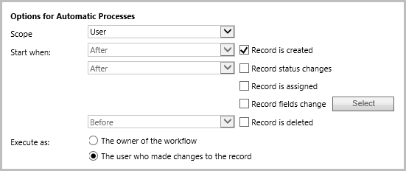
Real–Time Configuration

Slide 40
Real–Time Configuration: Scope
Same as background workflows

Slide 41
Real–Time Configuration: Start When
Record is created (after)
Record status changes (before or after)
Record is assigned
Record field changed
Record is deleted (before)

Slide 42
Real–Time Configuration: Execute As
The owner of the workflow
The user who made the changes to the record

Slide 43
Troubleshooting and Management

Slide 44
Workflow Failures
Two types of failures
Soft
Hard

Slide 45
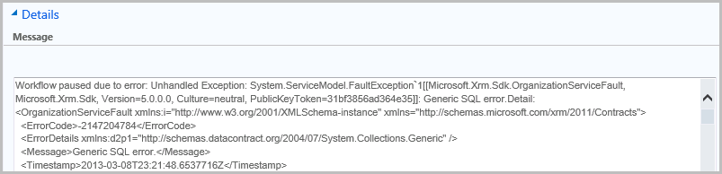
Error Example

Slide 46
Reviewing System Jobs
Build Personal Views
Monitor system jobs on a regular basis
Take action to correct issues

Slide 47
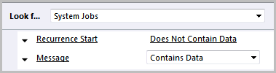
Personal View #1
System Jobs with Messages

Slide 48
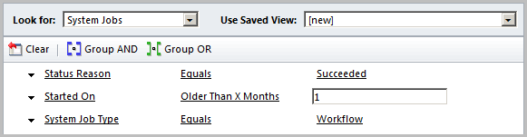
System Job Management: Bulk Delete
Remove successful workflows

Slide 49
Security

Slide 50
Security

Slide 51
Working with Solutions

Slide 52
Solutions

Slide 54
Best Practices

Slide 55
Performance (On Premises)

Slide 56
Performance (On Premises)
You may configure multiple Async Servers
Maximum number is four

Slide 57
Best Practices
Have smaller workflows run as child processes instead of one large workflow

Slide 58
Best Practices
Periodically examine your workflows and remove those that are unused

Slide 59
Extending Workflows

Slide 60
Extending Workflows
Custom Workflow Activities
.NET DLL
Added using Plug–in Registration Tool
Add additional steps

Slide 61
Additional Resources
MSCRM Workflow Utilities
Delete record
Share or “unshare” a record
Insert hyperlink to a CRM record
Qualify lead (convert to account/contact/opportunity)
Bulk activate / deactivate records
Cascade activate / deactivate operations to child records.

Slide 62
Additional Resources
CRM DateTime Workflow Utilities
Add Business Days
Add Days
Add Hours
Add Minutes
Add Months
Add Years
Date Difference Days
Date Difference Hours
Date Difference Minutes
Date Difference Months
Date Difference Years
Get Day Number Of Week
Get Day Number Of Year
Get Day Of Week
Get Quarter Number Of Year
Get Week Number Of Year
Get Month Start/End Dates
Get Quarter Start/End Dates
Get Week Start/End Dates
Get Year Start/End Dates
Is Between
Is Business Day
Is Same Day
Relative Time String
ToDateTime
To UTC String

Slide 63
Additional Resources
CRM Email Workflow Utilities
Email Business Unit
CC Business Unit
Email Security Role
CC Security Role
Email Team
CC Team
Delete Email Attachments
Delete Email Attachments By Name
Send Draft Email

Slide 64
Additional Resources
CRM String Workflow Utilities
Contains
Create Empty Spaces
EndsWith
Join
Length
PadLeft
PadLeft Dynamic
PadRight
PadRight Dynamic
Regex Match
Regex Replace
Replace
Reverse
StartsWith
Substring
ToLower
ToTitleCase
ToUpper
Trim
Word Count

Slide 65
Additional Resources
CRM Numeric Workflow Utilities
Add
Average
Divide
Max
Min
Multiply
Random Number
Round
Subtract
ToDecimal
ToInteger
Truncates

Slide 66
Additional Resources
MS Dynamics CRM 2011 Bulk Workflow Execution Tool
From ZeroToTen

Slide 67
Demonstration

Slide 68
Discussions

Slide 69
Questions?

Slide 70
Thank You

